Slide 1
Social Network Analysis
Identifying Important Individuals
within a Group

Slide 2
How do you know who is important?
Social Network Analysis:
Interdependence among social actors
Patterns of relationship > Individual attributes

Slide 3
What kinds of relationships?
Friendship
Family
Romance/Dating
Advice Seeking
Attending Events Together
Doing Activities Together
Buying, selling, trading
Communication: email, text, phone, etc.

Slide 4
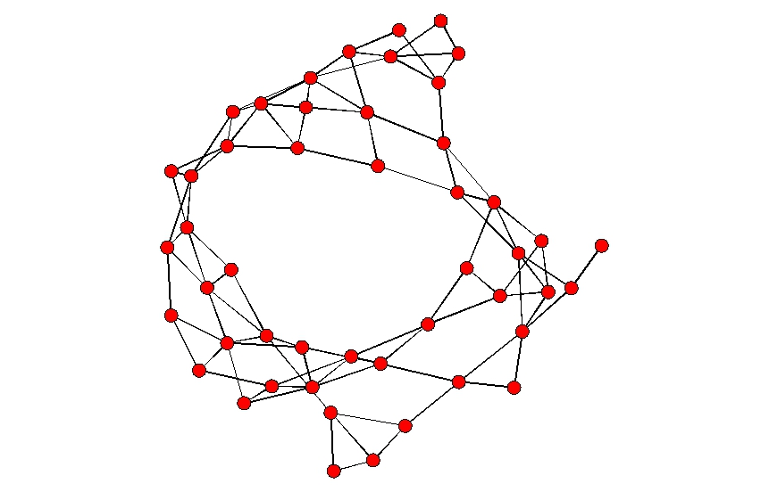
Representing Networks

Slide 5
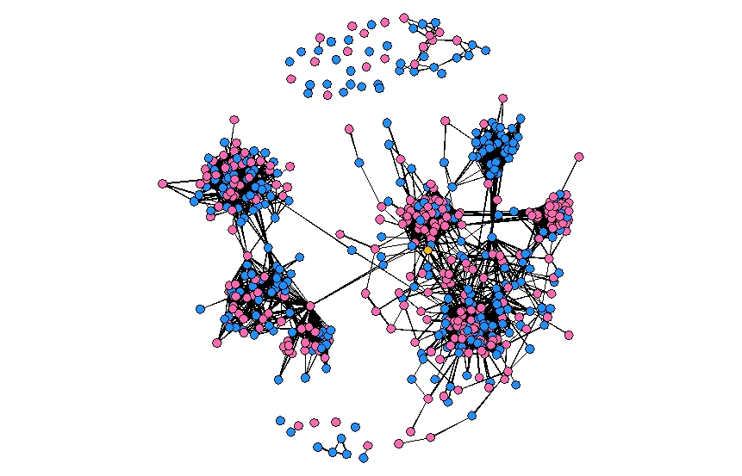
Social Media

Slide 6
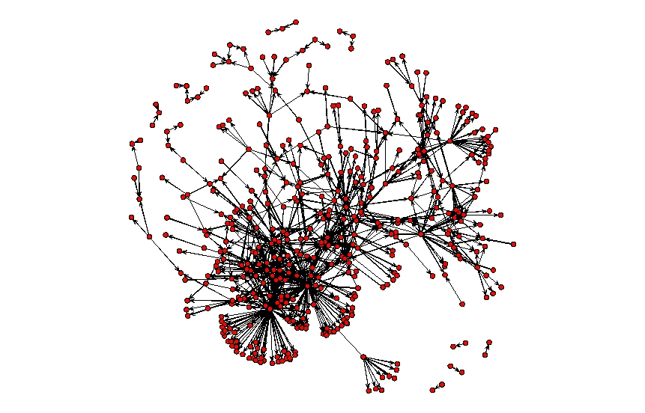
Preventing Infectious Diseases

Slide 7
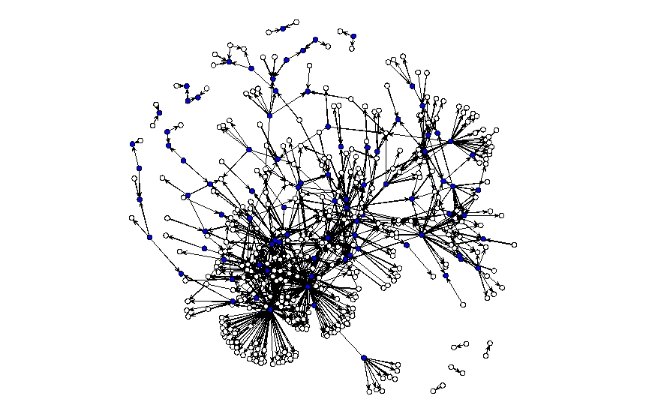
Preventing Infectious Diseases

Slide 8
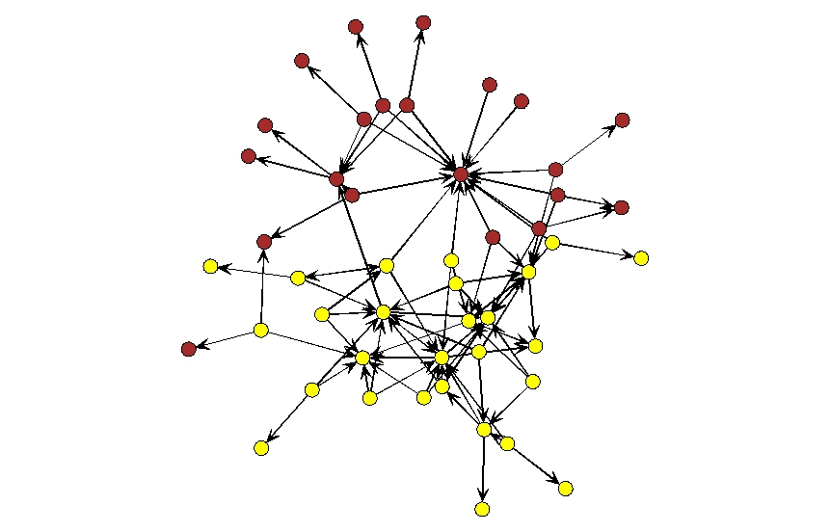
Gaining Access to a Social Setting

Slide 9
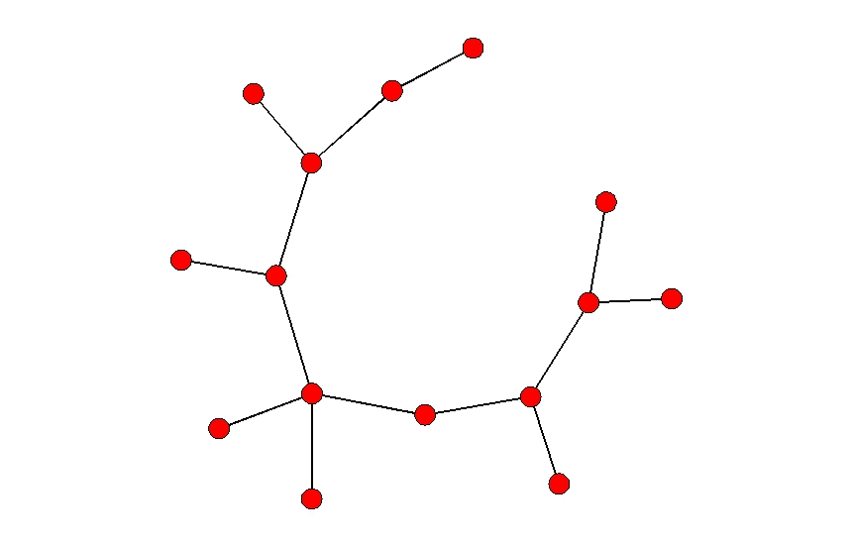
Hard to Reach Populations Or a terrorist communication net?

Slide 10
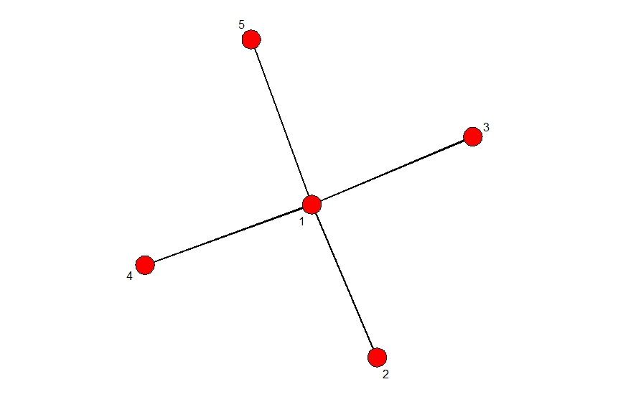
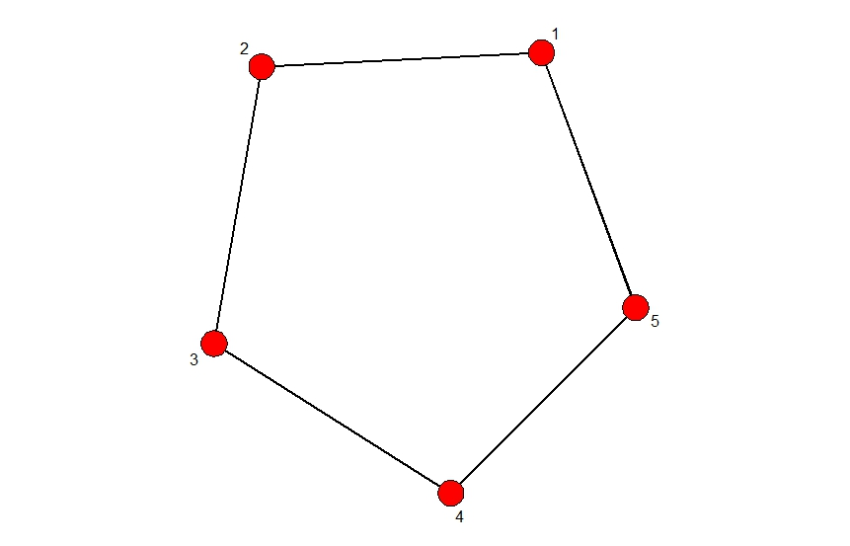
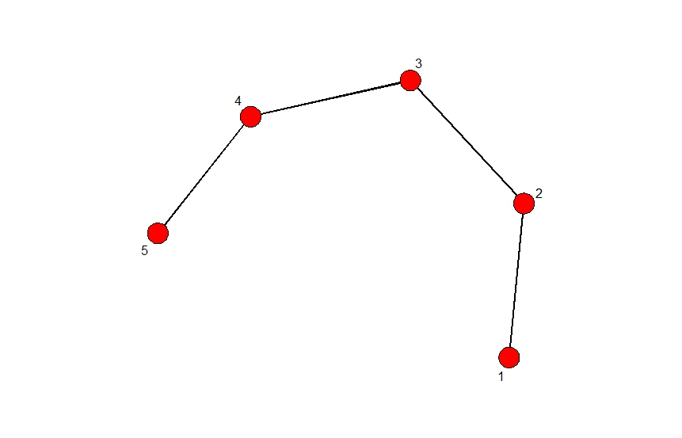
What does centrality look like?

Slide 11
Measuring Centrality
Degree
# of connections to a single node
Being central means having lots of connections
Closeness
Being able to easily/quickly reach other nodes
Being central means being relatively close to all other nodes
Betweenness
Being able to connect other nodes together
Being central means controlling flow in the network

Slide 12
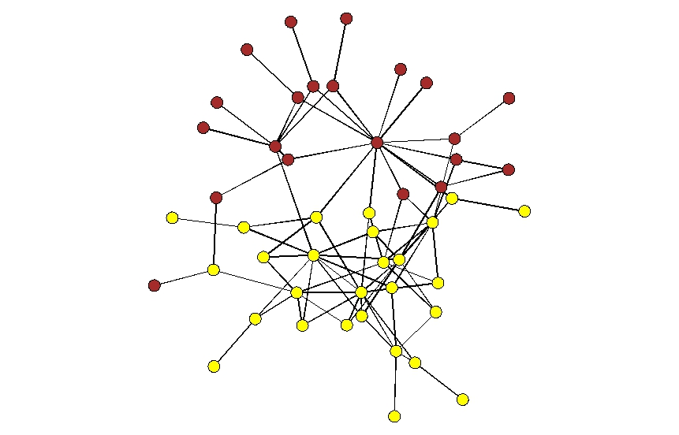
Gaining Access to a Social Setting

Slide 13
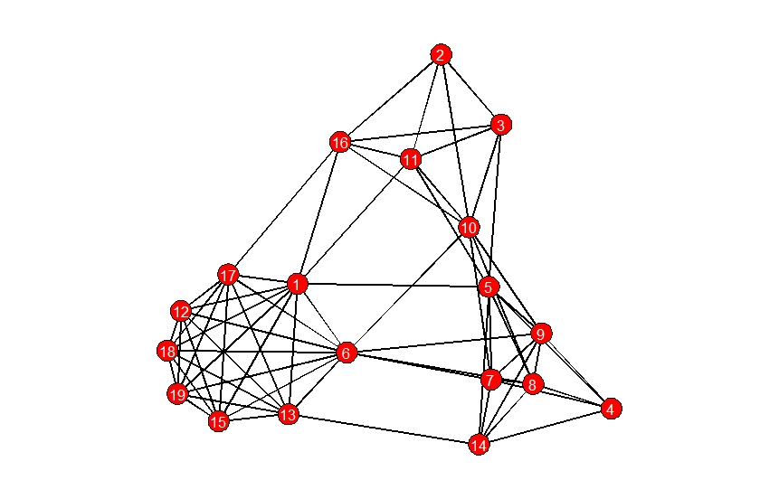
Disrupting Terrorist Cells

Slide 14
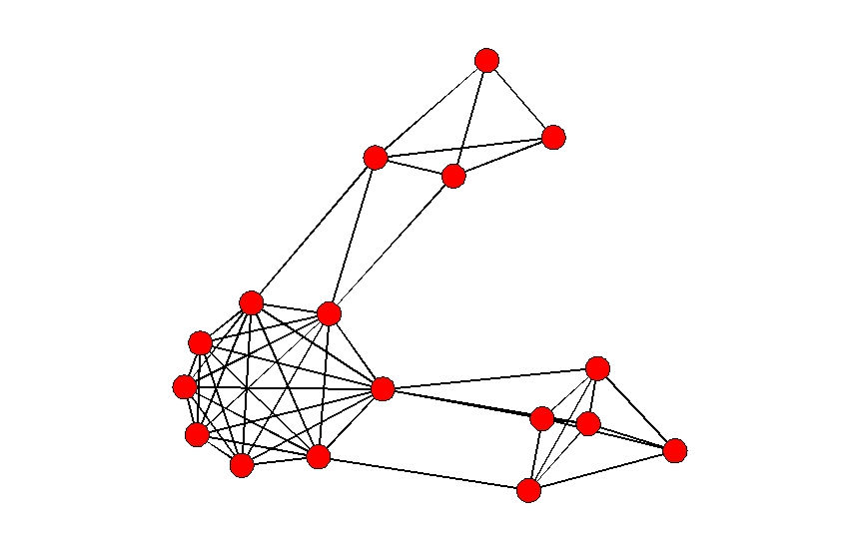
Disrupting Terrorist Cells

Slide 15
Disrupting Terrorist Cells

Slide 16
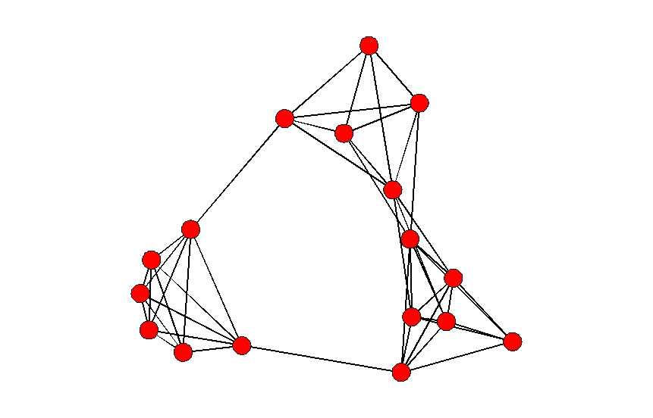
Disrupting Terrorist Cells

Slide 17
9/11 Hijacking Network

Slide 18
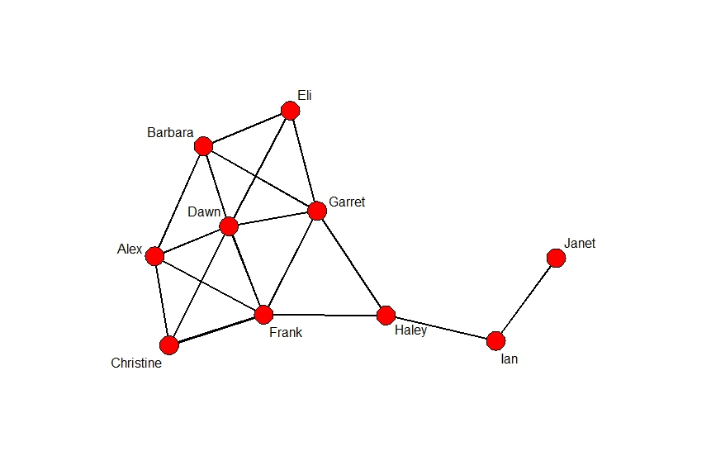
Essay Prompt

